Slide 1
Mars Express Power Challenge
Group 6 BAE Systems

Slide 2
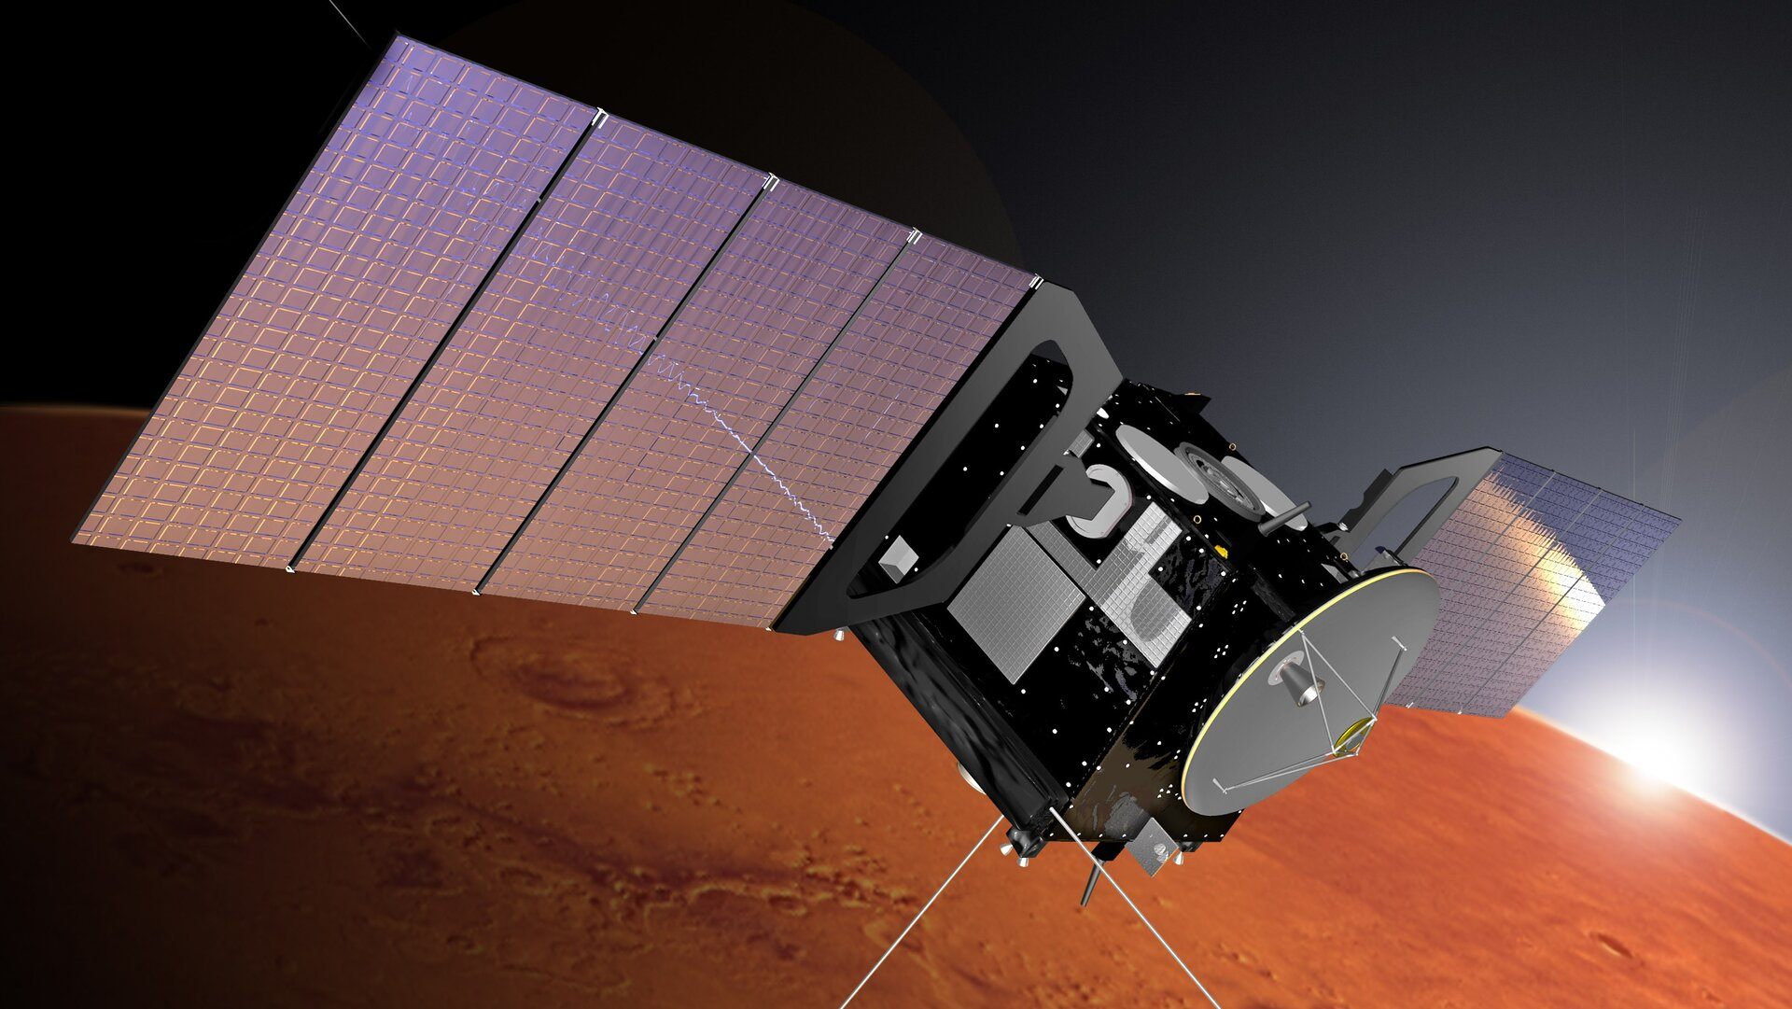
About Mars Express Orbiter (MEX)
A spacecraft launched by the European Space Agency (ESA) in 2003.
Provides invaluable scientific data.
Contains an autonomous thermal system for regulating temperature.
Uses electric power from solar panels (or batteries during eclipses)
Science Power = Produced Power - Platform Power - Thermal Power
Predicting power consumption is crucial for optimising space operations and ensuring the longevity of MEX.
Notes:
Providing 3D images, mapping the chemical composition of the atmosphere, and so on.

Slide 3
About the Mars Express Challenge
MEX Flight Control Team from ESA collected three Martian years’ (2061 Earth days, from 22/08/2008 to 14/04/2014) worth of MEX’s telemetry data.
Data was then released as part of a machine learning challenge in 2016.
Develop predictive models that could predict the average electric current of 33 power lines per hour for the fourth Martian year (687 Earth days, from 14/04/2014 to 01/03/2016).

Slide 4
Objectives
Develop a machine learning model to predict the average hourly electric current for each of the 33 thermal power lines on MEX.
Evaluate the model’s performance using Root Mean Squared Error (RMSE).
Present our findings to Mr Gordon and the UoM team.
Notes:
“We are doing the same challenge”

Slide 5
About the Data
Dataset included four Martian years of data, categorised into two main parts:
Context data (independent variables):
SAAF
FTL
DMOP
EVTF
LTDATA
Observation data (dependent variable):
Hourly electric current measurements for each of the 33 power lines over the first three Martian years.
The observation data for the fourth Martian year was never released.
Our project uses 20% of Year 1-3 data as unseen test data.

Slide 6
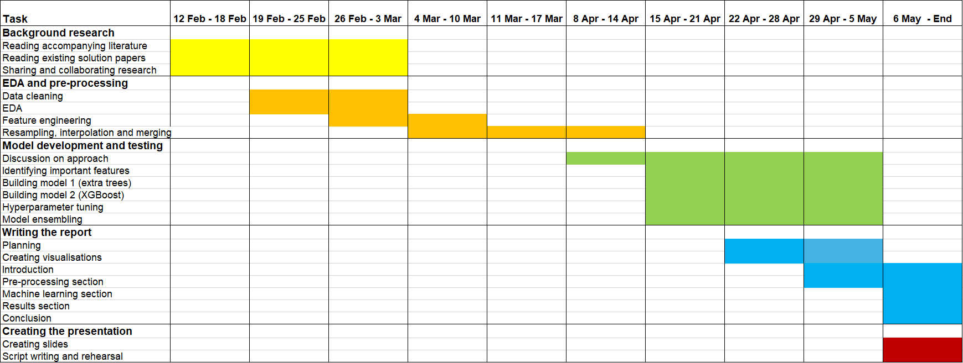
Project Timeline

Slide 7
SAAF (Solar Aspect Angles) Files
Provide information about the spacecraft's orientation with respect to the Sun:
ut_ms: Unix timestamp in milliseconds
sa: Solar aspect angle (angle between the spacecraft's solar panels and the Sun-MEX line)
sx, sy, sz: Solar angles of the X, Y, and Z axes of the satellite, respectively

Slide 8
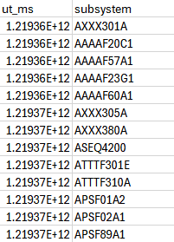
DMOP (Detailed Mission Operations Plan) Files
Contain commands sent to various subsystems of the spacecraft:
ut_ms: Unix timestamp in milliseconds
subsystem: Name of the operated subsystem command

Slide 9
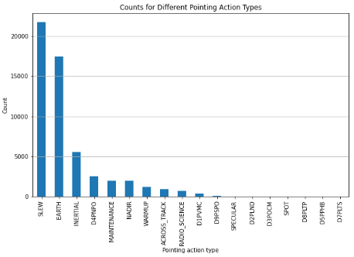
FTL (Flight Dynamics Timeline) Files
Contain spacecraft pointing events:
utb_ms: Unix timestamp in milliseconds of the beginning of the pointing period
ute_ms: Unix timestamp in milliseconds of the end of the pointing period
type: Type of pointing or action
flagcomms: Boolean indicating if any communication device was used

Slide 10
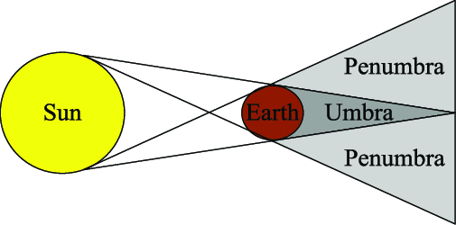
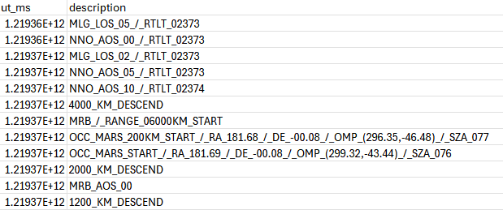
EVTF (Event Files)
(Event) files, which contain descriptions of other events such as umbras, penumbras, or changes in altitude:
ut_ms: Unix timestamp in milliseconds
description: Short description of the event

Slide 11
LTDATA (Long-Term Data) Files
Provide daily measurements of various parameters related to the spacecraft's environment:
ut_ms: Unix timestamp in milliseconds (one sample per day)
sunmars_km: Distance between the Sun and Mars in kilometers
earthmars_km: Distance between Earth and Mars in kilometers
sunmarsearthangle_deg: Sun-Mars-Earth angle in degrees
solarconstantmars: Solar constant at Mars in W/m²
eclipseduration_min: Total duration of all eclipses in the day, in minutes
occultationduration_min: Total duration of all occultations in the day, in minutes

Slide 12
Feature Engineering
Context File | Features Selected | Comment
SAAF | sa, sx, sy, sz | No additional feature engineering was necessary.
DMOP | command, ON/OFF pairs, no_of_subsystem_commands | Various engineering attempts made. Referred to an existing solution on Github for ON/OFF pairs.
FTL | flagcomms, pointing action types | Dummy variables created for different pointing action type.
EVTF | altitude, direction, umbra, penumbra, time_since_last_pericentre_ms | Converting strings into various binary and integer features.
LTDATA | earthmars_km, sunmarsearthangle_deg, solarconstantmars, eclipseduration_min, occultationduration_min | No additional feature engineering was necessary.

Slide 13
Data Resampling and Merging
Context files initially contained varying time granularities and date ranges.
Solution: Resampling all files to a consistent hourly time granularity.
Initially considered a time granularity of 30 seconds, but found it infeasible.
Techniques used:
Linear interpolation and mean imputation for numerical features.
Forward or backward filling for binary features.
The resampled files were then merged into a single dataset.
Notes:
Discussion on switching from 30 secs to 1 hour.

Slide 14
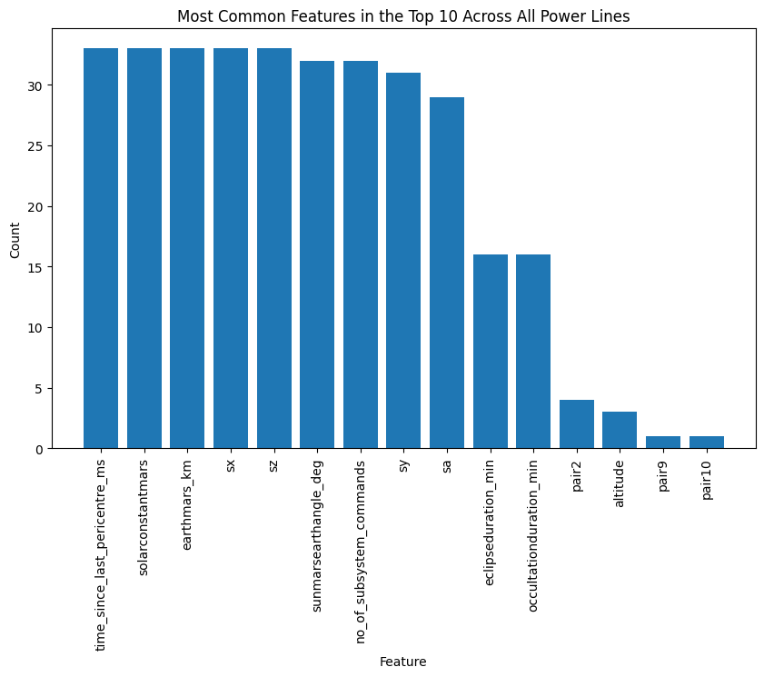
Feature Selection
Built 33 simple Extra Trees models for each power line.
Extracted feature importances.
Picked the top 20 for each power line.
Notes:
Subsequent models were built using only these top 20 features. This helped remove features that were redundant to each power line, reducing model complexity and improving performance.

Slide 15
Predicting the Thermal Power Consumption
Models:
Extra Trees:
Well-suited for large, high-dimensional datasets.
Effective for feature importance identification.
Reduces overfitting through random thresholds.
XGBoost:
Handles large datasets efficiently.
Delivers high predictive performance.
Tackles complex relationships within the data.
Performed hyperparameter tuning using a random search and cross-validation.
Used ensembling to leverage the strengths of both, creating a third model.

Slide 16
Results
Extra Trees Mean RMSE: 0.0981
XGBoost Mean RMSE: 0.0978
Ensemble Mean RMSE: 0.0976

Slide 17
Challenges and Improvements
Lack of official documentation
Incorporation of lag features
Sheer size of the dataset

Slide 18
References
Akande, Y. F., Idowu, J., Misra, A., Misra, S., Akande, O. N., & Ahuja, R. (2022). Application of XGBoost Algorithm for Sales Forecasting Using Walmart Dataset. Lecture Notes in Electrical Engineering, 147–159. https://doi.org/10.1007/978-981-19-1111-8_13
alex-bauer. (n.d.). alex-bauer/kelvin-power-challenge. GitHub. Retrieved May 7, 2024, from https://github.com/alex-bauer/kelvin-power-challenge
Campbell, A. (2017). Inverse square law - Energy Education. Energyeducation.ca. https://energyeducation.ca/encyclopedia/Inverse_square_law
Chen, T., & Guestrin, C. (2016). XGBoost: a Scalable Tree Boosting System. Proceedings of the 22nd ACM SIGKDD International Conference on Knowledge Discovery and Data Mining - KDD ’16, 785–794. https://doi.org/10.1145/2939672.2939785
ESA. (n.d.). Mars Express. Www.esa.int. https://www.esa.int/Science_Exploration/Space_Science/Mars_Express
Jia, X., Xu, M., Pan, X., & Mao, X. (2017). Eclipse Prediction Algorithms for Low-Earth-Orbiting Satellites. IEEE Transactions on Aerospace and Electronic Systems, 53(6), 2963–2975. https://doi.org/10.1109/taes.2017.2722518
Kelvins - Mars Express Power Challenge. (n.d.). Kelvins.esa.int. Retrieved May 7, 2024, from https://kelvins.esa.int/mars-express-power-challenge/home/
Lucas, L., & Boumghar, R. (2017). Machine Learning for Spacecraft Operations Support - the Mars Express Power Challenge. https://doi.org/10.1109/smc-it.2017.21
shelfwise. (n.d.). shelfwise/Mars-Express-Challenge: 3rd place solution to the Mars Express Power Challenge hosted by the European Space Agency. GitHub. Retrieved May 7, 2024, from https://github.com/shelfwise/Mars-Express-Challenge
stephanos-stephani. (n.d.). stephanos-stephani/MarsExpressChallenge. GitHub. Retrieved May 7, 2024, from https://github.com/stephanos-stephani/MarsExpressChallenge

